Slide 1
Automated Explainability in Healthcare Shelly Jain, Artemio Rimando, Gage Sowell
Notes:
This is the slide where you actually SAY your 1-2 sentence elevator pitch. Engage your audience!!

Slide 2
Problem
Extensive manual labor is needed to identify mitotic figures across whole slide images by pathologists. It is often:
Time consuming
Difficult to articulate reasons
Difficult to agree on diagnosis between pathologists
Notes:
Specify what Problem is being solved, and ensure that everyone is in agreement as to Why that’s a problem.

Slide 3
Solution
Machine Learning and AI can help eliminate issues faced by pathologists by automatically
Searching for mitotic figures in WSI using object detection
Classifying cell patches as mitotic or non-mitotic using image classification
Explaining classification predictions visually using class activation maps
Explaining classification predictions textually using dual encoder
Notes:
Specify what Problem is being solved, and ensure that everyone is in agreement as to Why that’s a problem.

Slide 4
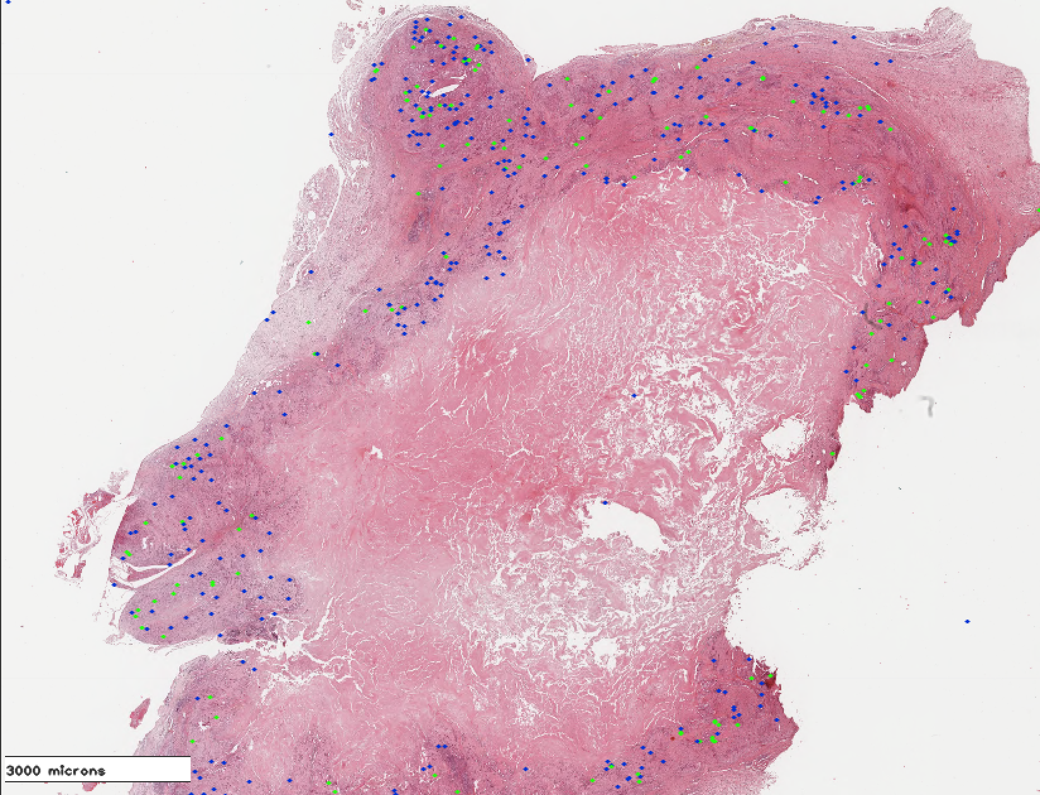
Understanding Whole Slide Image (WSI) Data
High resolution microscopy images of canine breast cancer tissue
Expert pathologists labeled cells in 21 WSIs as mitotic (green dots) or non-mitotic figures (blue dots)
Annotations and locations on WSIs stored in SQLite database

Slide 5
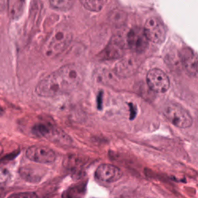
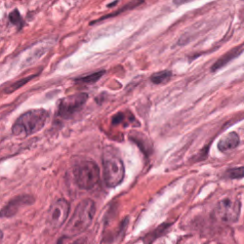
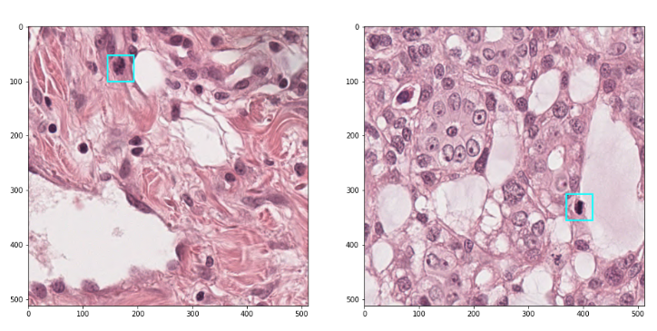
Obtaining Image Patches
Mitotic figure
Non-mitotic figure
Two datasets generated
512 px images for object detection model
Mitotic figures only, non-mitosis mapped to background
50x50 px ground truth bounding box
Randomly cropped
250 px images for cell patch classifier model
Two classes: mitotic and non-mitotic
Top row: 250 px patch examples (positive and negative)
Bottom row: 512 px patches of MFs with bounding boxes

Slide 6
Data Lineage
ML modeling pipeline
⇆
AWS Deployment Stack
WSI data
⇆
⇆
Raw .svs images
AWS S3 Bucket & Google Drive
Text explanation generation
Sample text
Image patch generation
SQLite database
250 px patches for cell classifier model
Training sets
Mitotic figure descriptions
Annotations
Test sets
512 px patches for object detection model
Non-mitotic figure descriptions
Bounding boxes

Slide 7
ML Pipeline Deep Dive

Slide 8
ML Pipeline Diagram
Data Handling
ML Modelling
Predictive AI
Explainable AI
Unseen WSI
Systematic Image Segmentation
Mitotic Object Detection
Cell Patch Classifier
Visual Explainability
Grad CAM
Textual Explainability
Dual Encoder
A
B
D
C
Overlapping 512 px patches
250 px patch candidates
Final convolution layer of classifier
Classified patch sent for text translation
A
B
C
D

Slide 9
Mitotic Object Detection Motivation
Goal: To find mitotic figures across the WSI
Generate random 512 px crops around annotations and ground truth bounding boxes
Train Faster RCNN (ResNet50) with PyTorch
Model will generate patch candidates for cell patch classifier in next stage of ML pipeline
Set | Examples
Training | 8396
Validation | 2099
Test | 3412

Slide 10
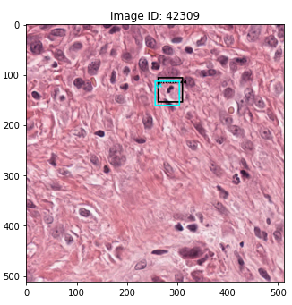
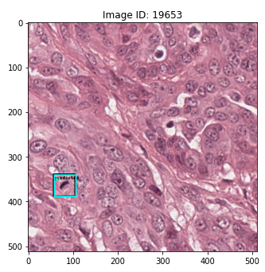
Faster RCNN Parameters and Performance
Key hyperparameters
Epochs = 5
Batch size = 16
Initial learning rate = 0.005
Momentum = 0.9
Model performance
Mean IoU = 0.86
Mean scores = 0.88
Predicted (black) and ground truth (cyan) bounding boxes on test set images

Slide 11
Cell Patch Classifier Motivation
Mitotic figure
Non-mitotic figure
Goal: To classify patch candidates as mitotic or non-mitotic
Generate training/validation set of 250 px patches around mitotic and non-mitotic annotations
Fine tune ResNet18 with PyTorch
Set | Mitotic examples | Non-mitotic examples
Training | 8396 | 21964
Validation | 2099 | 5491
Test | 3412 | 8920

Slide 12
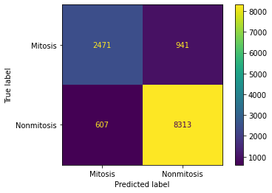
ResNet18 Parameters and Performance
Key hyperparameters
Epochs = 25
Batch size = 64
Initial learning rate = 0.01
Momentum = 0.9
 | Precision | Recall | F1-Score | Support
Mitosis | 0.8 | 0.72 | 0.76 | 3412
Nonmitosis | 0.9 | 0.93 | 0.91 | 8920
Model performance
Accuracy = 0.87
F1-score (mitosis) = 0.76

Slide 13
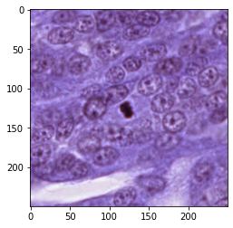
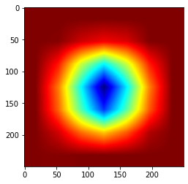
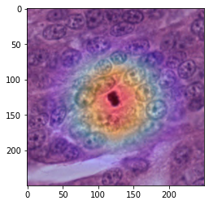
Visual Explainability using Grad-CAM
Grad-CAM has 2 main steps:
Determine final convolution layer in the network
Examine the gradient information flowing into that layer
Gradients as weights are used to highlight important regions in images
Input Image
Heat Map
SuperImposed
Notes:
it computes importance score based in the gradients to produce a heatmap highlighting the important regions within the image that resulted in a given class label.

Slide 14
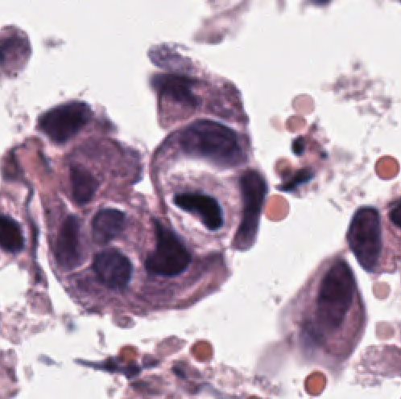
Textual Explainability Using Dual Encoder
Image embeddings are created through the vision encoder via pre-trained ImageNet
Text embeddings are created through the text encoder via pre-trained BERT (English Uncased)
Dual encoder learns image-to-text embeddings by minimizing the average loss over image and text loss functions
Text Output: “Classification for this image is asymmetric anaphase structure. This is explained by two chromosomes clusters of unequal sizes which are depicted.”

Slide 15
DEMO

Slide 16
Deployment Stack

Slide 17
Deployment pipeline
AWS back-end
Front-end UI
WSI received
Systematic image segmentation
Object detection
Cell patch classifier
User uploads WSI
Core models
Data-handling
User receives report
Explainability report generation
Grad CAM
Dual-encoder
Explainability models
Model summary
Model predictions

Slide 18
Thank You! Questions?

Slide 19
APPENDIX

Slide 20
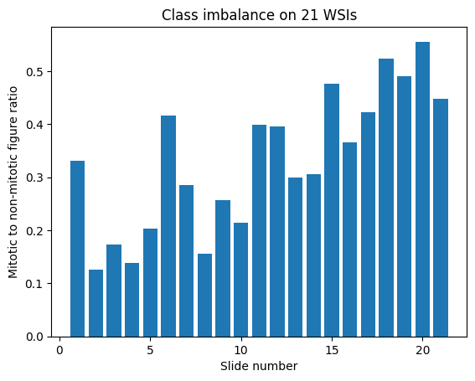
EDA
Mitotic figures (MF) are part of a mammary carcinoma grading scheme
13907 total MF examples
36379 total non-MF examples
Mild - Moderate¹ class imbalance on WSIs
mean | std | min | median | max
0.33 | 0.13 | 0.13 | 0.33 | 0.56
¹Google ML foundational courses: Imbalanced data

Slide 21
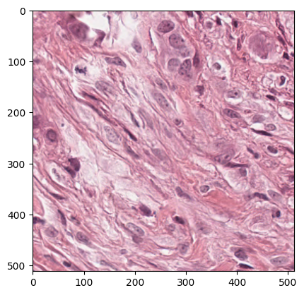
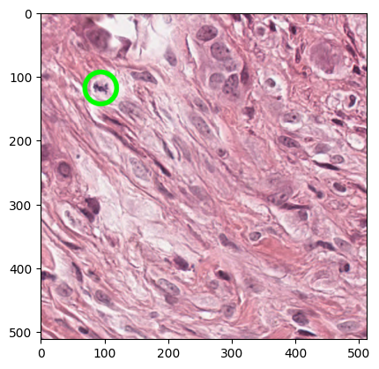
Current progress - EDA
WSI image example
MF annotation example

Slide 22
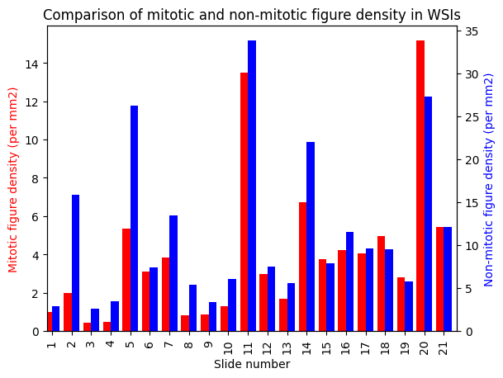
Current progress - EDA
Statistic | area (mm2) | MFs density (MFs/mm2) | Non-mit density (Non-mit/mm2)
mean | 207.6 | 4.0 | 11.4
std | 140.5 | 3.9 | 8.9
min | 26.3 | 0.4 | 2.6
median | 226.4 | 3.1 | 7.9
max | 513.3 | 15.2 | 33.8

Slide 23
Data Lineage
Mitotic Figures Object Detection
WSI Data Download
SQLite
Google Colab
Cell Patch Classifier
Heatmap using
Grad-CAM
AWS Deployment Stack
Report
Annotations
AWS S3
AWS
SageMaker
Image-Text
Dual Encoder
Training Set
bboxes
Testing Set
Sample Text Describing Cancer Cells
Fake Text Explanations

Slide 24
ML pipeline - core model
Overlapping 512 px patches
Unseen WSI
Systematic image segmentation
WSI object detection model
250 px patch candidates
Cell patch classifier
Explainability models
Data handling
Two-stage Mitotic Figure Detection
Explainability features

Slide 25





ML Pipeline - core model training
+
250 px patches of MFs and Non-MFs
Cell patch classifier
250 px test data
Fine tuned ResNet18
Model evaluation
⇆
Model/data iteration
⇆
AWS Deployment Stack
512 px patches of MFs with bounding boxes
WSI object detection model
512 px test data
Fine tuned Faster RCNN

Slide 26
Deployment of ML Pipeline

Slide 27
Next Steps
Code freeze, Migration & Deployment in AWS
Deployment Pipeline
Front-end UI - Determine feasible interface (web-based etc.) for uploading/importing WSIs (large files) and receiving the auto-generated explainability report
Report format - Determine format for compiling report with predictions, heatmaps, and text explanations
Getting out of the notebook - Employ all data-handling and model prediction functions in .py files for containerization
Readiness for final demo

Slide 28

Automated Explainability in Healthcare Shelly Jain, Artemio Rimando, Gage Sowell
Notes:
This is the slide where you actually SAY your 1-2 sentence elevator pitch. Engage your audience!!

